Slide 1

Smart village
Leveraging technology for sustainable rural development using data analysis
DEPARTMENT OF COMPUTER AND COMMUNICATION ENGINEERING
TEAM MEMBERS:
ABISHEK RPD
MOHANA SUBI
PRAMIKA
SANJAYKUMAR N

Slide 2

Problem Statement
In many parts of the State, Rural areas lag behind Urban regions in terms of economic development, healthcare, education, proper food, and basic infrastructure.

Slide 3





The Problem
Healthcare - Sanitation
Education
Food - Water
Agricultural Productivity
Logistics

Slide 4
Abstract
The abstract introduces Smart Village, a strategy for rural development leveraging technology and data analysis dashboards.
It outlines components such as agricultural monitoring, healthcare management, Food-water supplies, education enhancement, logistics, and sanitation.
A Dashboard (Web page) is developed i.e. integrated with Data Analysis of the Rural Region.

Slide 5
Abstract
Aim
Smart Villages aims to address rural challenges sustainably while empowering communities and fostering innovation using a Dashboard integrated with Data Analysis.
Promise
This approach promises transformative impacts on rural livelihoods and overall quality of life, aligning development efforts with local needs and priorities for long-term sustainability.

Slide 6
Literature Review
Title: "Data Analytics for Rural Development: Opportunities and Challenges"
Journal: International Journal of Rural Management
Authors: Smith, J., & Patel, R.
Abstract: This article explores the opportunities and challenges associated with leveraging data analytics for rural development initiatives. It discusses various case studies and best practices, highlighting the potential impact of data-driven approaches in transforming rural communities.
2. Title: "Predictive Analytics for Resource Allocation in Rural Healthcare: A Case Study"
Journal: Journal of Healthcare Informatics
Authors: Gupta, S., & Kumar, A. on the application of predictive analytics for optimizing resource allocation in rural
Abstract: This study presents a case study of healthcare systems. It demonstrates how machine learning algorithms can be used to forecast healthcare demands and allocate resources efficiently, leading to improved healthcare access and outcomes in rural areas.

Slide 7
Literature review
3. Title: "Enhancing Agricultural Productivity through
Data Analytics: Lessons from Smart Farming Initiatives" Journal: Journal of Agricultural Informatics
Authors: Sharma, P., & Singh, V.
Abstract: This article reviews various smart farming initiatives that utilize data analytics to enhance agricultural productivity in rural areas. It discusses the role of sensor technology, satellite imagery, and predictive modeling in optimizing farming practices and resource management.
4. Title: "Community Engagement and Empowerment through Data-Driven Decision-Making: Lessons from Rural Development Projects"
Journal: Community Development Journal
Authors: Jones, L., & Brown, K.
Abstract: This paper examines the impact of data-driven decision-making on community engagement and empowerment in rural development projects. It presents case studies and practical examples, demonstrating how data analytics can facilitate participatory decision-making and foster community ownership of development initiatives.

Slide 8
Literature review
5. Title: "Optimizing Service Delivery in Rural Areas through Data Analytics: A Review of Best Practices“
Journal: Journal of Public Administration Research and Theory
Authors: Chen, Y., & Li, H.
Abstract: This review article synthesizes the best practices and methodologies for optimizing service delivery in rural areas using data analytics. It discusses strategies for improving service accessibility, quality, and effectiveness, drawing insights from successful case studies and implementation experiences.

Slide 9

Block diagram
Rural Communities
Data Collection
Data Analysis
Integrate Data Analysis with Web page Dashboard
Invest
Healthcare -Sanitation
Education Enhancement
Logistics
Agricultural Productivity

Slide 10
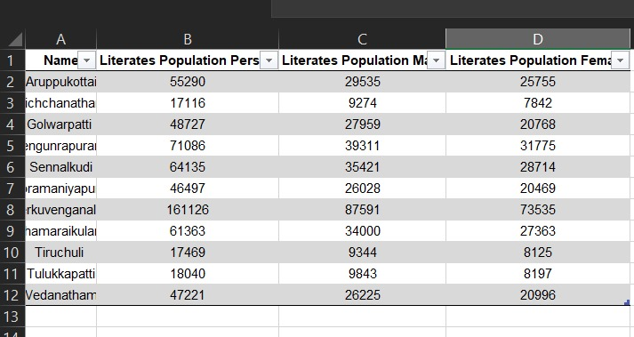
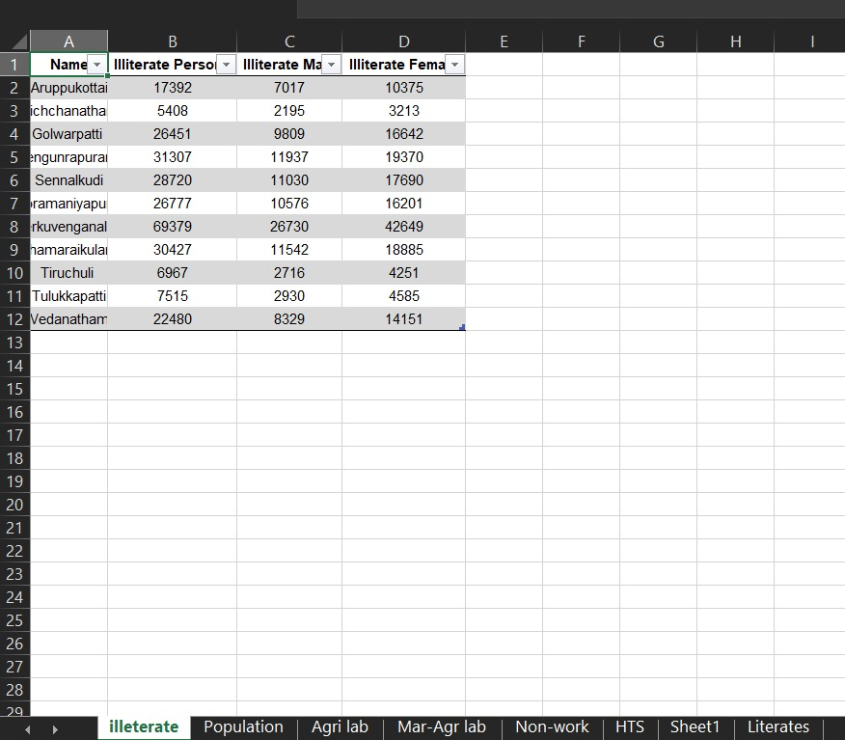
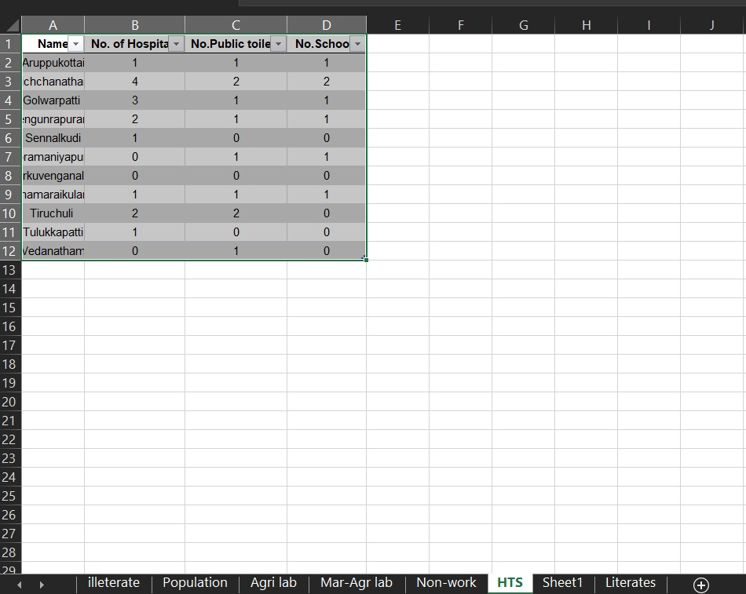
Datasets
Literates , Illiterates, Availability of Hospitals, Schools, Public Toilets

Slide 11
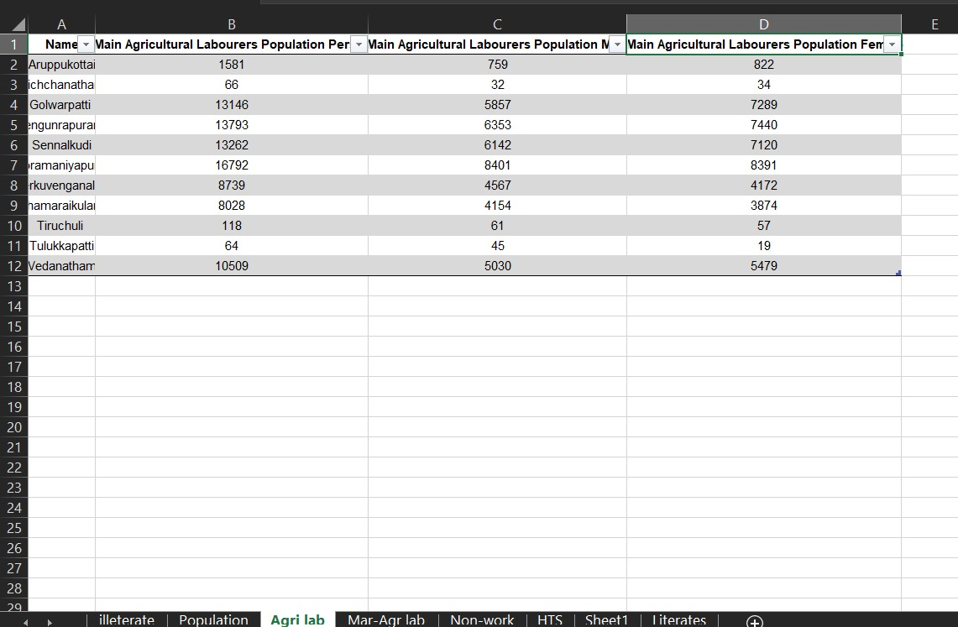
Datasets
Agricultural Labourers

Slide 12
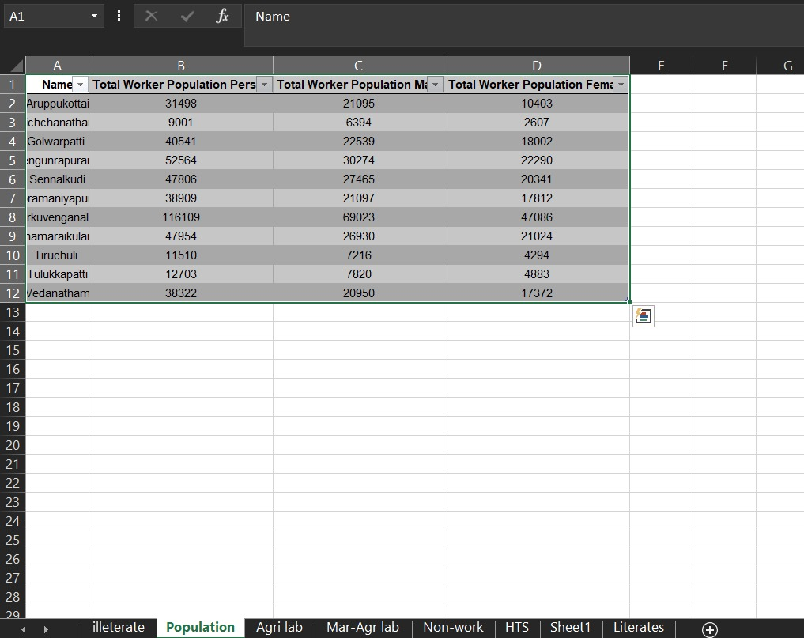
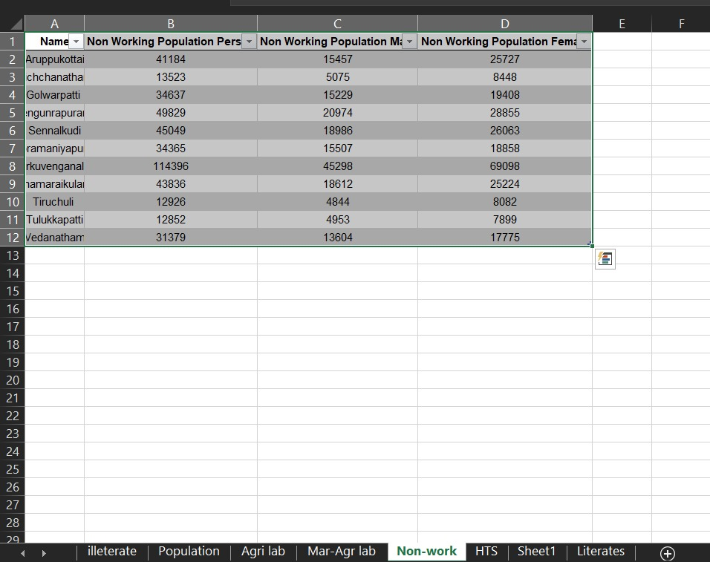
Workers and Non-Workers Population

Slide 13
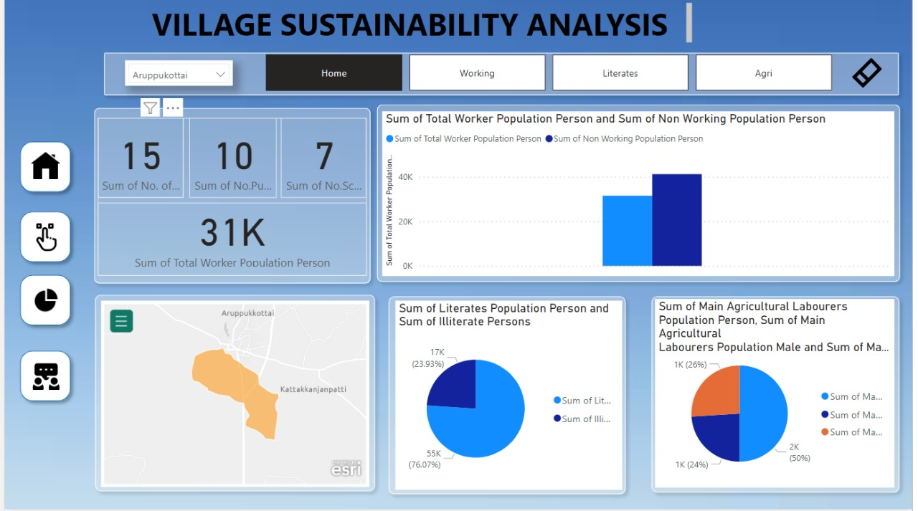
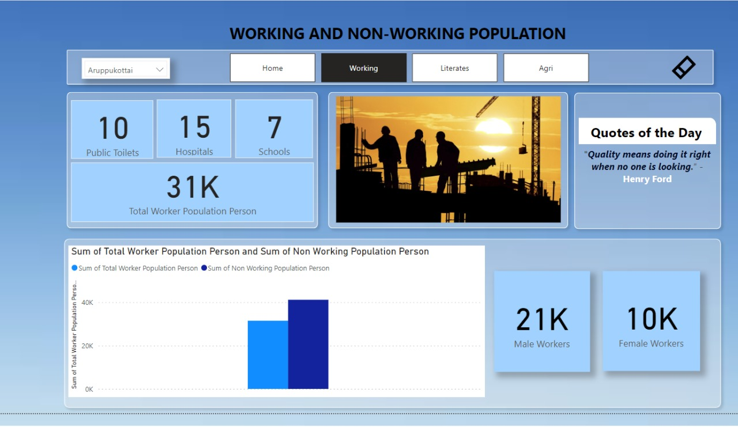
RESULT

Slide 14
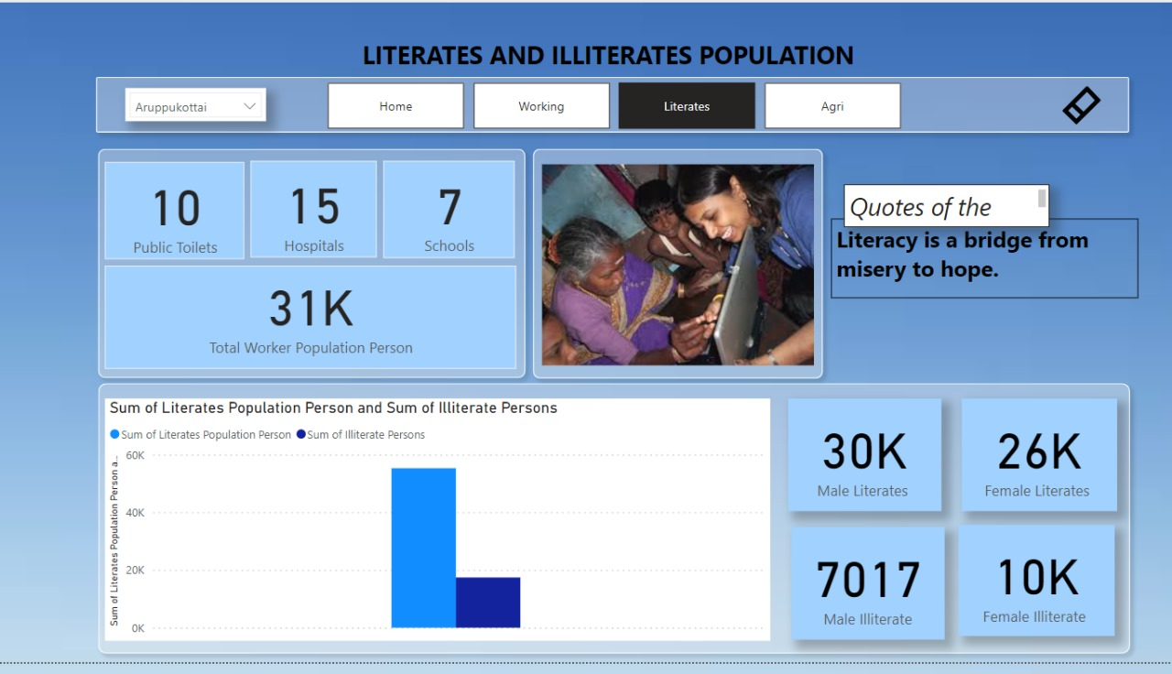
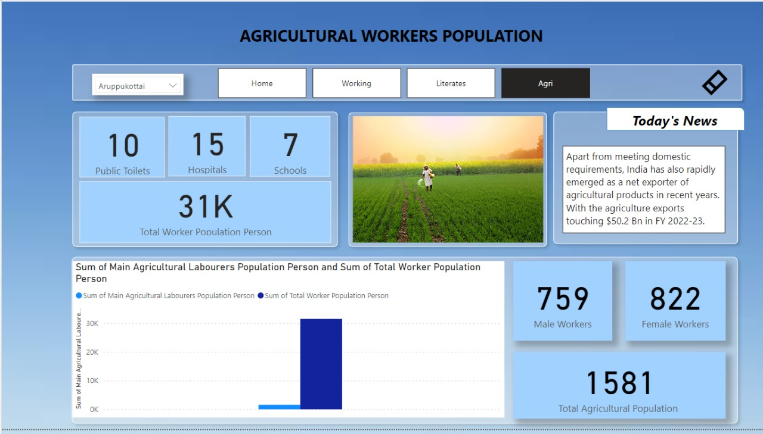
RESULT

Slide 15
Reference
https://www.researchgate.net/publication/344161970_Framework_for_Data_Analysis_in_the_Context_of_the_Smart_Villages
https://www.tandfonline.com/doi/full/10.1080/23311886.2023.2219118
https://utilitiesone.com/smart-villages-creating-sustainable-rural-communities-with-communication-technologies
https://typeset.io/questions/how-can-technology-be-used-to-improve-the-lives-of-people-2cyvlnqk0h
https://www.e4sv.org/wp-content/uploads/2015/07/Smart-Villages-New-Thinking-for-Off-grid-Comunities-Worldwide.pdf
https://www.scribd.com/document/462693609/Concept-Project-Information-Document-Integrated-Safeguards-Data-Sheet-Niger-Smart-Villages-for-rural-growth-and-digital-inclusion-P167543

Slide 16

Thank You
- Let’s develop our rural regions through Data Analysis.

